Slide 1

Progress Report
Group 4
2022
Group Members:
YUKI,TAKERU
PETE,BRUCE,ERIC,PONNIE,SHIN

Slide 2
01.Hardware
CONCENTS
02.Software

Slide 3
01
Hardware Progress

Slide 4
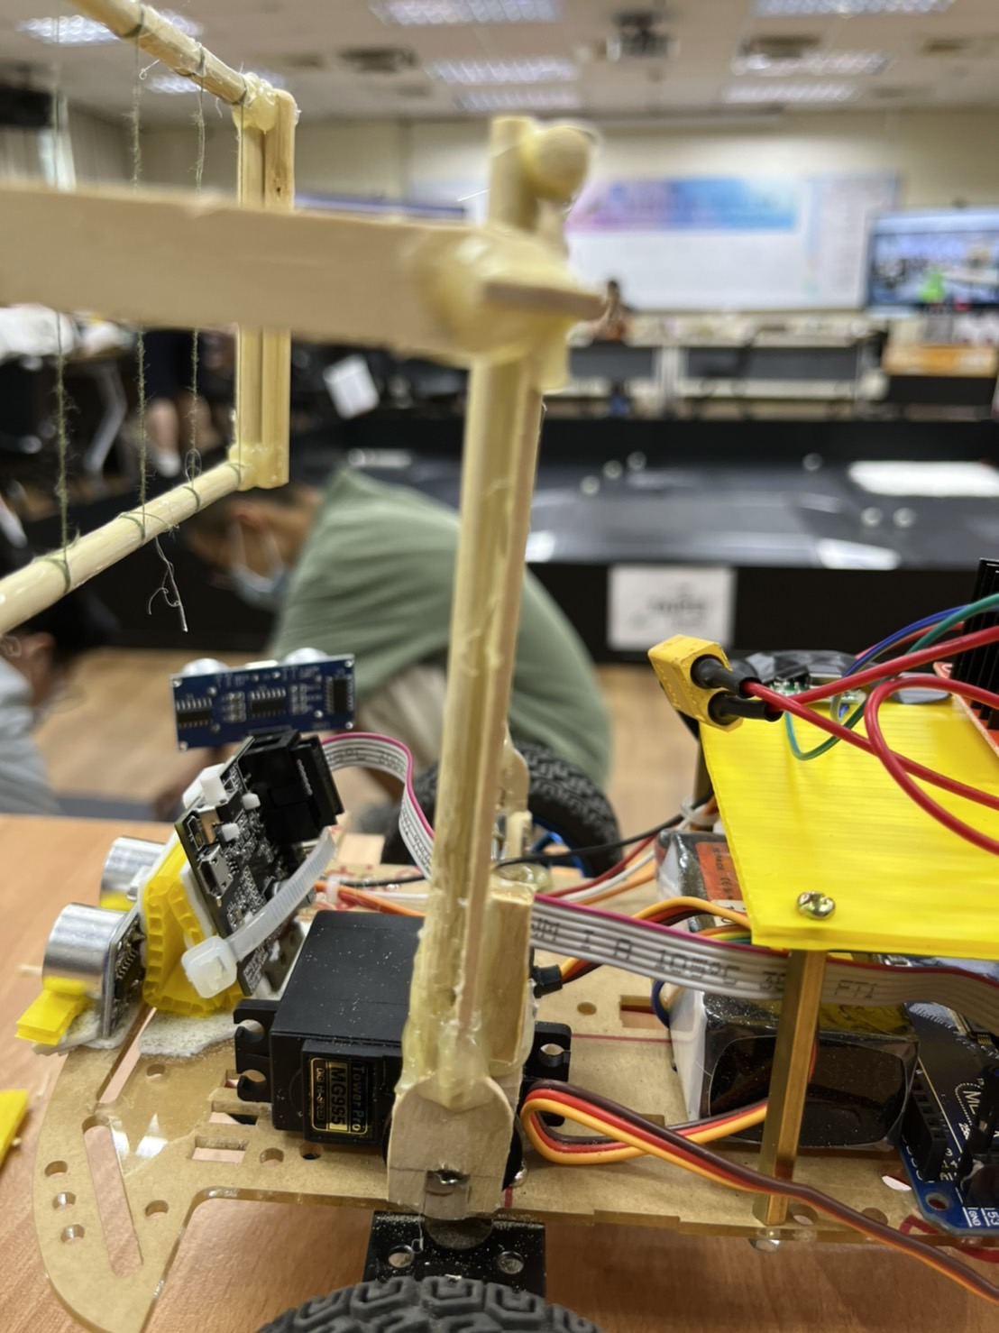
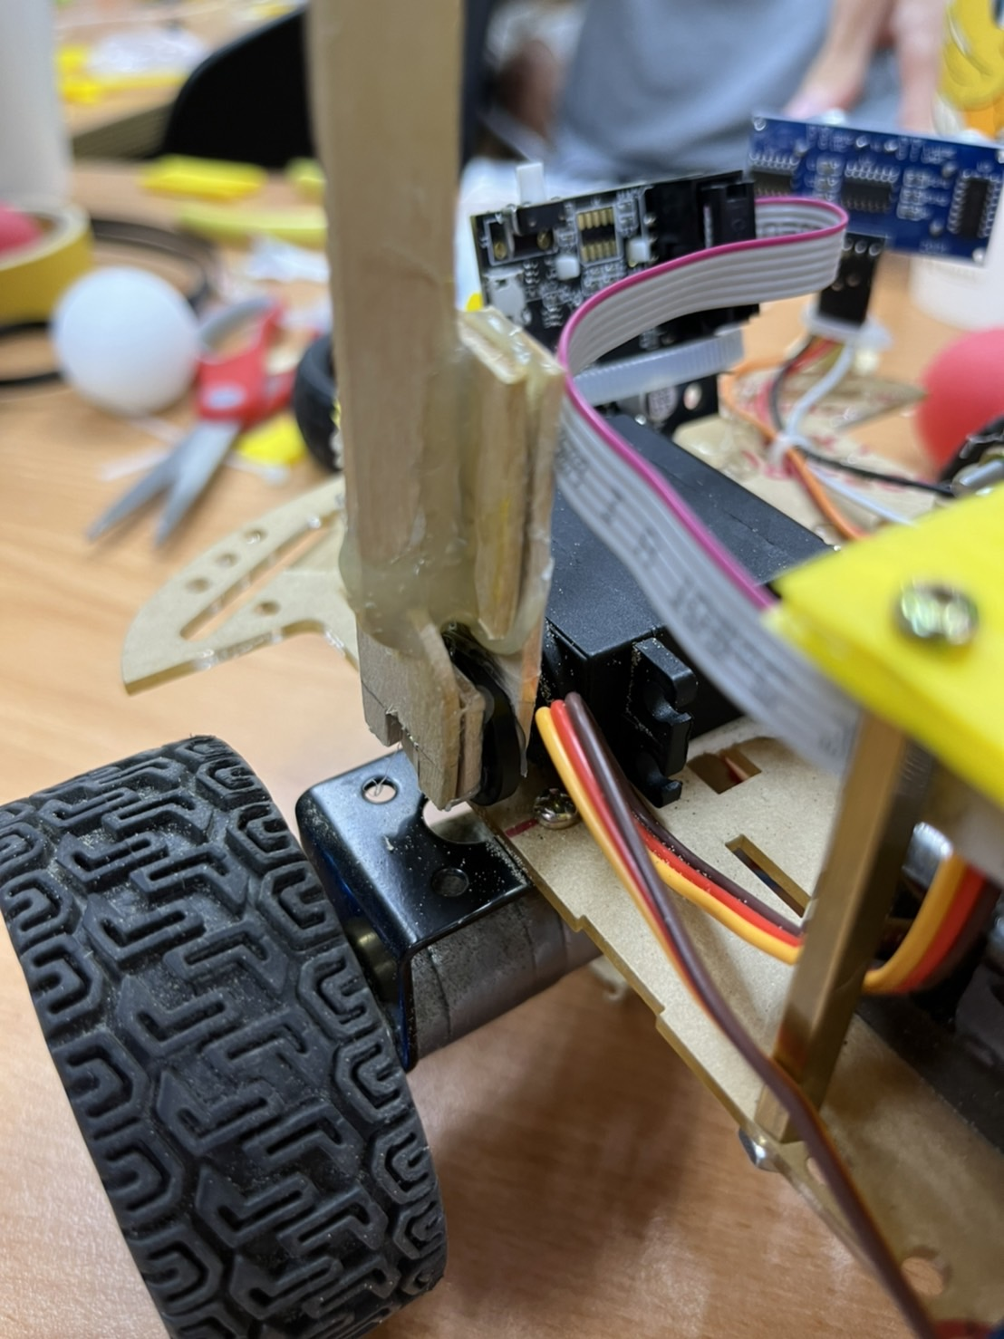
Strength the ball-chatching mechanism
Notes:
We have upgrade the will to increase the fraction to the floor

Slide 5
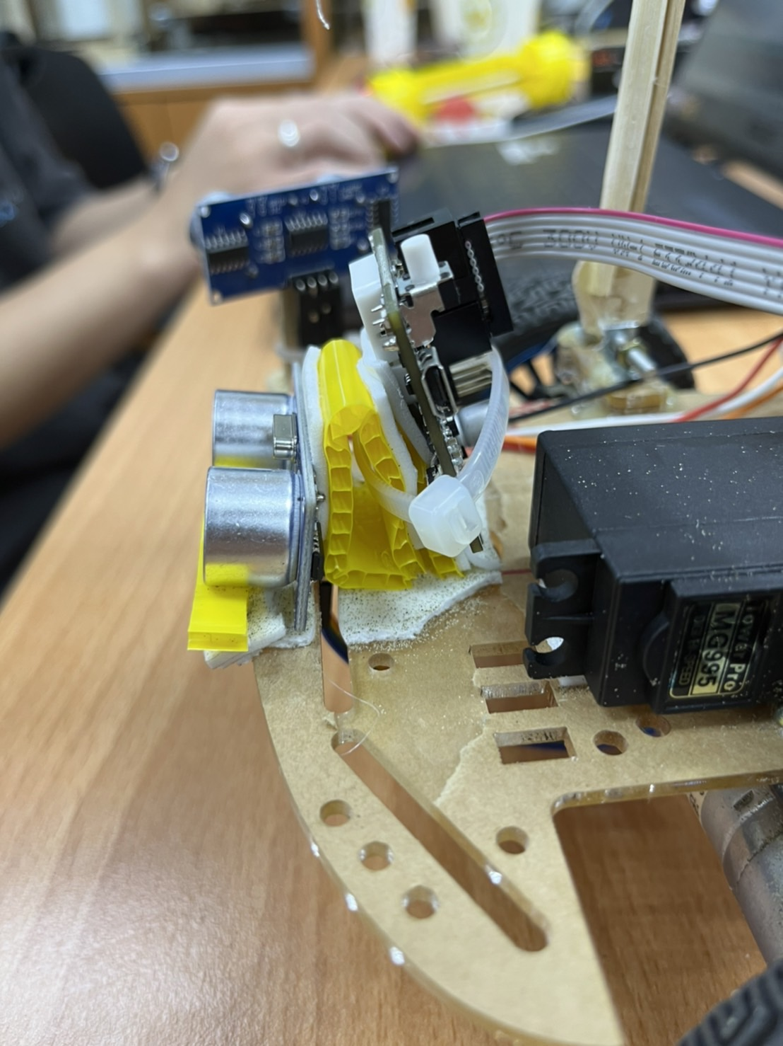
Adjust the position of the sensor
Notes:
We have upgrade the motor to 12V motor. Which has more power for climbing hills and crossing obstacles. And we changed the 5v battery pack to 12v li-po battery to provide more juice.

Slide 6
02
Software Progress

Slide 7
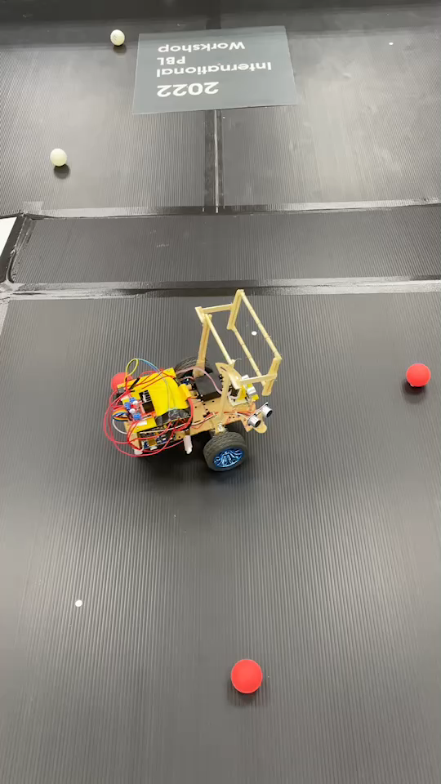
Some variable adjustment
Notes:
We have upgrade the motor to 12V motor. Which has more power for climbing hills and crossing obstacles. And we changed the 5v battery pack to 12v li-po battery to provide more juice.

Slide 8
What we are going to do next:
1.Basket to store the balls
2.A “ball stop” in front of the car
3.Improvement of the sonic sensor detection
4.More try and error

Slide 9
THANK YOU

